Slide 1
pyScoreboard
An automated program to record and save scores of two table tennis players

Slide 2
Libraries required
1. tkinter
2. time
(both are included in python 3.8 standard installation

Slide 3
Features

Slide 4
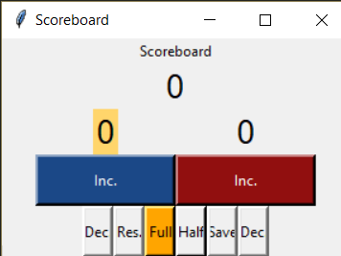
Base GUI - Buttons
Buttons:
1. Inc increases score of the respective player i.e Blue or Red
(Blue always has the first serve)
2. Res resets the scores back to zero
3. Dec decreases the score if inc is pressed accidentally
4. Full/Half is the game type Full is for full game of 21 and Half is a game of 11
5. Save keeps the record in a .txt file

Slide 5
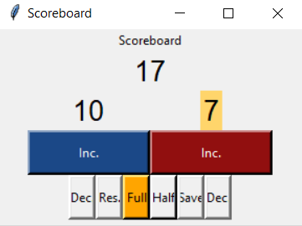
Base GUI - Features
Features:
1. Service is indicated by a yellow highlight
2. Service alternates every 5 serves
3. Your game type full or half is indicated by the yellow highlight in Full/Half
4a. The first digit shows the total serves
4b. The left digits shows the blue score
4c. The right digit shows the red score
5. You can register a win only if your score is grater or equal to 21 AND score difference between the two players is greater or equal than two. This rule is portrayed in the next slide

Slide 6
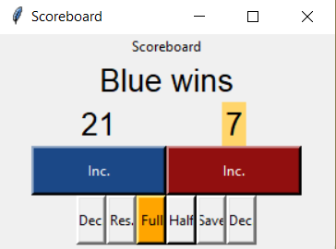
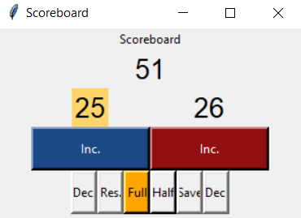
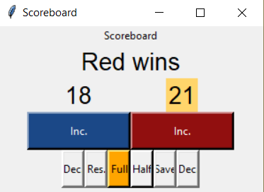
Winning
Conditions (AND type)
1a. Score >=21 (full)
1b. Score >=11 (half)
and
2. |Blue score–Red score| >=2
Both conditions are satisfied in case 1 and case 2 so the game is registered as a win and the buttons (inc) are now inactive
If the conditions are not satisfied then the game continues indefinately.

Slide 7

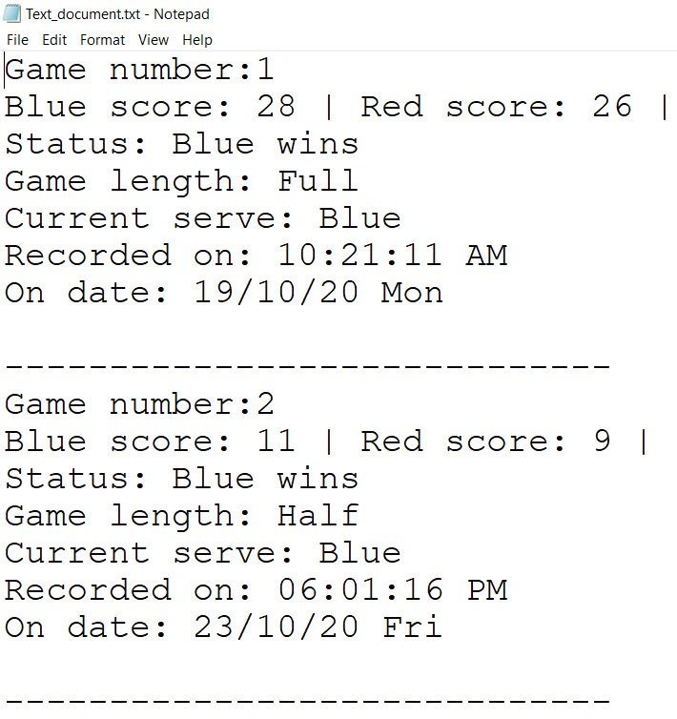
Save feature – File Handling
Save function:
1. The program uses file handiling to save the game status
2. It uses three files last_game.txt (volatile), Text_document.txt (long term memory) and srno.txt (stores game number)
Details saved:
1. Game number
2. Scores
3. Winner
4. Game length
5. Current serve
6. Date & time of the game

Slide 8
Additional info
1. The source code is provided in the folder/repository
2. The program is built by using no external libraries.
3. A minimum of 40 KB of storage is required
4. The program is written in Sublime text 3 text editor and is interpreted by python 3.8

